Slide 1
Incident Management
Mandatory Training -ITSM Access

Slide 2
Mandatory Trainings for ITSM Access
INCIDENT MANAGEMENT PROCESS
MAJOR INCIDENT MANAGEMENT PROCESS
P1/P2 TECHNICAL COMMUNICATION PROCESS
P1/P2/ DOWN-GRADE COMMUNICAITON PROCESS
QC 10.21 001-v9 (ID 230786).(SOP)
QC 10.21-v10 (ID 229134).(SOP)
QC 15.01.001-v13.(SOP)
Implications on IT NON-CONFIRMITY
SLAs surrounding P1 to P4.

Slide 3
Procedure followed – ITSM Access
Once training is completed by application support person.
Support Person should clear the assessment conducted by SMO Lead/Compliance Manager (Ramana Nandam).
Once Interview is cleared & upon confirmation from Ramana, You need to update the details in share point site (Ref Documentation slide).
You can track the status in share point.
All the request for addition to Support Group will need to be updated in the below Abbott Sharepoint link.
Link: http://team.oneabbott.com/gis/ctsbssms/SMO/Lists/Support%20Group%20Access%20Request%20%20%20ITSM/Allitemsg.aspx?ShowInGrid=True&View=%7BE8F9DC78%2D7260%2D4B48%2D8898%2D2CC33231CF9B%7D&InitialTabId=Ribbon%2EList&VisibilityContext=WSSTabPersistence
This tracker has been developed to ensure information provided is first time right with all necessary information for us to provide the access without any delays and also keep track of who requested this information.
The List consists of the following mandatory details to be provided.

Slide 4
Point Of Contacts
For all clarification please write to below email address:-
Nandam, Ramana M ramana.nandam@abbott.com
Balaji, KS Balaji.KS@cognizant.com
Kailash Melwani Kailash.Melwani@cognizant.com
Incident Managers OneAbbottINCManagers@cognizant.com
ITSM Team OneAbbottITSM@cognizant.com
SMO OneAbbottSMO@cognizant.com
PROBLEM Management OneAbbottPROBLEMMGMT@cognizant.com
Monitoring Team AbbottMonitoringTeam@cognizant.com

Slide 5
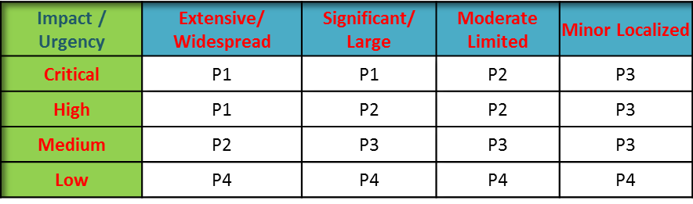
Sample Questions
1. What is Incident or Incident Management?
Ans .Incident Management Team restore services as quickly and efficiently as possible with the least amount of impact to the business, along with increasing the visibility and communication of incidents to business and maintaining user satisfaction with the quality of IT services.
2. What is SERVICE REQUEST FULFILLMENT?
Ans. Request Fulfillment is the process of handling and fulfilling standard service requests throughout their lifecycle. These are not Standard Changes, not incidents and also not non-standard service requests (aka requests for enhancements towards Work Intake). Examples would be “how-to questions”, request to change data, requests for information (eg requests to provide a log file to support an audit), password resets and database table space changes (as they don’t influence how the application functions these are treated as service requests).
3.Core Activities of IM?
Ans. Identification & detection
Logging & classification
Major incident (P1/P2) management
Initial investigation & resolution (1st level support)
Investigation & resolution (2nd and 3rd level support)
Monitoring
Escalation
Closure
Reporting.
4.Classification of Business Impact?
Ans. Extensive / Widespread: The entire enterprise site or more than 1,000 users could be affected.
Significant / Large: Either an entire division or 100 to 1,000 users could be affected.
Moderate Limited : Either an entire business unit or 2 to 100 users could be affected.
Minor Localized : One person could be affected.

Slide 6
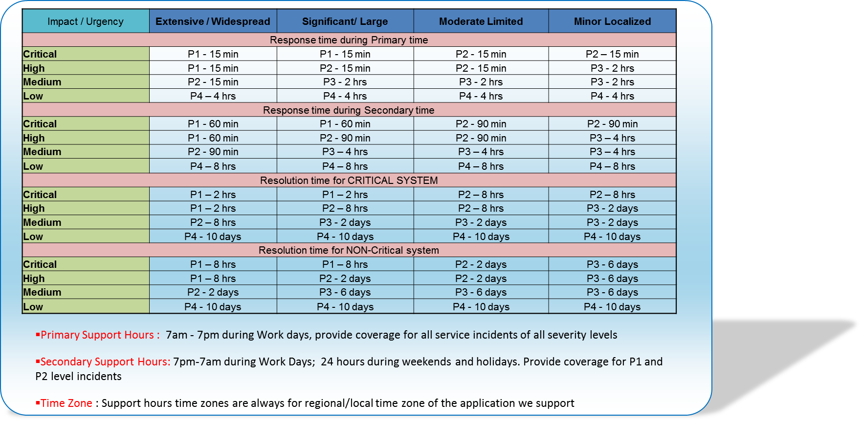
Sample Questions
5.Urgency Classifications of an Incident.
Critical - User is unable to work. System is non-functional. Critical Systems or business functions are adversely affected.
High- User is able to work but significant functionality is unavailable. Non-critical System missing prior functionality.
Medium -User is able to work, but minor functionality is unavailable. Non-critical System missing minor functionality. Reasonable Workaround has been employed successfully.
Low - Incidents/Service Requests logged by Abbott’s Service Desk, which are a result of request for increased functionality for New Services, not a failure in the IT infrastructure. System enhancement request.
6.What is agreed SLA.?

Slide 7
Sample Questions
7.Can Application team create ticket in ITSM?
Ans. No, we need to call GSD to create new ticket.
8.Once ticket received in your queue, what are basic steps you will check.
Ans. Should check Impact, Urgency, Priority & Incident Type are set correctly, if its incorrect we need to amend accordingly.
Eg: If service request is created as service restoration/Incident, we should change it.
If priority set as high but the incident doesn’t qualify for high, reduce the priority & inform SMO Incident Management team with in 15 minutes & update the work log with reason for downgrading.
SMO IM Process for P1 & P2 incidents– Mandatory to Know
For all P1 Critical & P2 High incidents, an technical communication should be sent to Business stake holders by SMO Incident Managers & team will be initiating bridge to get technical information from application team.
Application support team should join the bridge in order to provide communication, if not Escalation Procedure will be followed .
Initial technical communication should be sent in 30 minutes.(By SMO IM Team)
For Critical P1 incident - every ONE hour till the issue is resolved an technical communication will be sent to stake holders, until application team should have to connect in Bridge & update the status/progress of the incident.
For High P2 incident - every TWO hour till the issue is resolved an technical communication will be sent to stake holders, until application team should have to connect in Bridge & update the status/progress of the incident.
For all P1 & P2 ticket is downgraded to Medium/Low priority as per business Impact (kindly refer SOP QC10 21 001-v9),should intimate SMO Incident Management team with downgrade communication template.
For all P4,P3 & P2 ticket is upgraded to High/Critical should intimate SMO Incident Management team & SMO IM team will follow the P1/P2 technical communication process as discussed above.
Product Categorization should be updated as mandatory field.
If incidents is not supported by your team, check internally with cognizant & route it to correct group with work log updated. Do not route it back to GSD without checking internally.
Notes:
Note : These are just sample questions & answers, for detail explanation please go through mandatory SOP QC10 21 001-v9 (ID 230786).(SOP)
QC10 21-v10 (ID 229134).(SOP) & QC15.01.001-v13.(SOP).

Slide 8
Audit Parameters
Step 11 Was ticket marked In Progress by the assignee and when active work effort began?
Step 14 Was ticket Impact/Urgency/Priority reclassified?
Step 16 Is Ticket a P1 or P2? Step 17 If Column I is Yes, was Abbott SME notification documented?
Step 19 Was CAPA Analysis documented prior to Resolution (See QC10.21) OR SR confirmation documented?
If Step 19= IT Nonconformity Yes, was Step 20 Invoke CAPA process followed?
Was Product captured upon creation of ticket? If no and created by MS, no point. If no and created by others, point. If Yes, point and point column N
If ticket was not categorized when created, was Product captured before Resolution? If yes, point. If No, no point
If additional information was required, was Step 23 followed before moving ticket to Pending Status?
Step 38 Was Knowledge Article Documented?
Step 40 If no Knowledge Article was used, was QC10.23 followed to crated or update the Knowledge DB?
Step 29 Client follow up for Resolution (Client follow-up/ communication -Client Confirmation or 3 attempts)
Was ticket updated during the life of the ticket (Initial Analysis, progress, 10 days min)?

Slide 9
Tickets Eligibility Criteria for CAPA Analysis (Audit parameter 4 & 5)
Incidents requiring CAPA evaluation are those related to:
Quality applications,
Infrastructure supporting quality applications,
Quality data, or
Security incidents
Related to the following issues, do not require an CAPA evaluation and are excluded:
Password resets, locked accounts, authorization requests
Installation of printers, software, other devices, etc.
User training and knowledge requests
Duplicate tickets
Monitoring threshold warnings on infrastructure
Service requests for such things as additional storage, file restores, etc.

